Slide 1


Predict House Prices
Regression Analysis

Slide 2
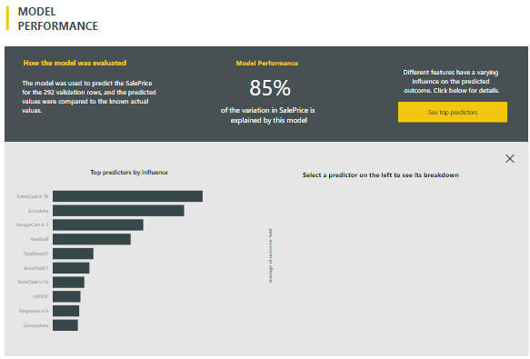


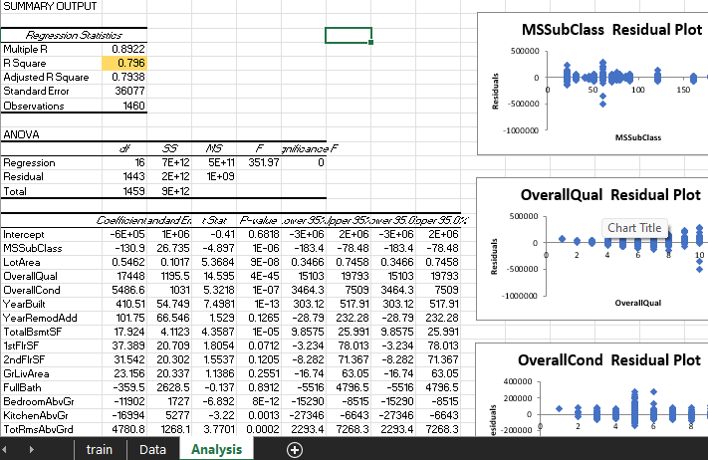
What did you build and how does it work?
I did a regression analysis in two different systems. PowerBI using machine learning, and Excel using the regression analysis function. To predict house prices.
Both use multiple regression analysis, but PowerBI also utilizes machine learning being able to evaluate more than just numeric values.

Slide 3
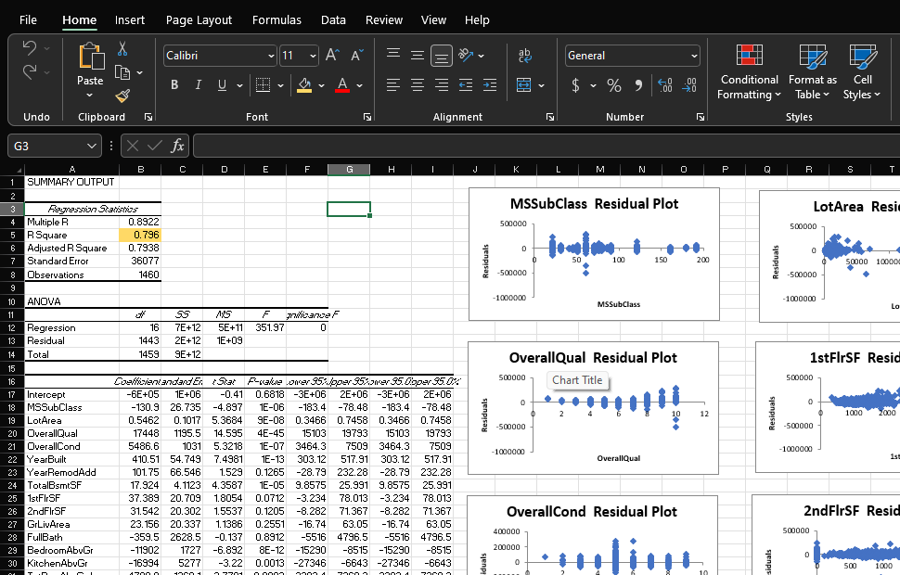
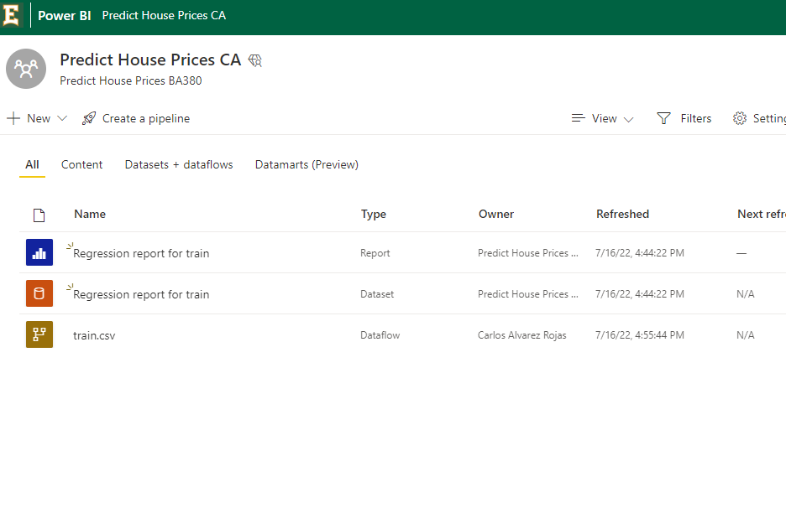
What is the purpose and objective of your project?
The purpose of this project is to practice multiple regression analysis with Excel and PowerBI. And the objective is to predict house prices according to a set of independent variables from the data.

Slide 4
What does your solution teach us about predicting your dependent variable (for example house prices)?
In excel I was able to get R square to .796 and PowerBI to were 85% of the variation is explained by the model, so these are pretty good predictions

